Slide 1
Text Summarization
SHIKHAR MAHAJAN
0801CS171077

Slide 2
Content / Text summarization
Content summarization is the way toward shortening the source archive into dense structure keeps generally thought regarding the record.
Automatic text summarization methods are greatly needed to address the ever-growing amount of text data available online to both better help discover relevant information and to consume relevant information faster.
The systems of content summarization approaches:
1. Abstractive
2. Extractive.

Slide 3
Need for text summarization
With such a big amount of data circulating in the digital space, there is need to develop machine learning algorithms that can automatically shorten longer texts and deliver accurate summaries that can fluently pass the intended messages.
Furthermore, applying text summarization reduces reading time, accelerates the process of researching for information, and increases the amount of information that can fit in an area.

Slide 4
Extractive summarization
Abstractive summarization
Extractive methods attempt to summarize articles by selecting a subset of words that retain the most important points.
This approach weights the important part of sentences and uses the same to form the summary. Different algorithm and techniques are used to define weights for the sentences and further rank them based on importance and similarity among each other.
Abstractive methods select words based on semantic understanding, even those words did not appear in the source documents. It aims at producing important material in a new way.
They interpret and examine the text using advanced natural language techniques in order to generate a new shorter text that conveys the most critical information from the original text.

Slide 5
TEXT SUMMARIZATION TECHNIQUES
Classification and sub-divisions of implementation techniques
Abstractive Summarization
Structure Based Approach
Tree based
Template based
Rule based
Ontology Based
Lead and body phrase based
Semantic Based approaches
Semantic Graph based
Multimodal semantic method
Information item (INIT) based
Extractive Summarization
Text Summarization using Fuzzy Logic
TF- IDF method
Cluster Based Method
Query Based Method
Machine Learning Method
Graph Theoretic Method
Latent Semantic Analysis (LSA) Method
Text Summarization using Neural Network

Slide 6
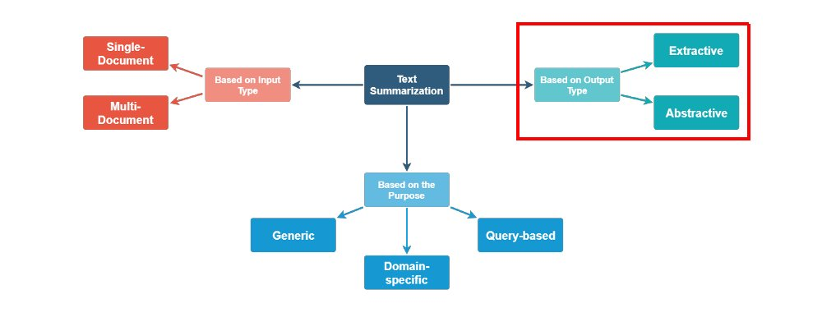

Slide 7
Text Summarization using Neural Network:
It involves certain steps to be implemented in which first phase includes the training of neural network A neural network (NN) after training is used which depicts the sentences type which is must to be involved within the summary to be generated. The second phase includes feature fusion which means combining those features which are important for inclusion in the summary. The third phase is selection of sentences which uses the modified neural network. Only the highly ranked sentences are selected by the modified neural network. This step controls the summary selection in terms of their importance

Slide 8
Machine Learning Method:
A training documents set along with its summaries in extractive form are given as input to the training stage. This approach views classification problem in text summarization. Machine learning approach
classified as supervised, unsupervised or semi-supervised.Sentences which posses the features are classified as summary sentences and the sentence which do not as non –summary sentences. Bayesian rule is used to statistically determine the classification probabilities (P (s∈<S | F1, F2, ..., FN)= P (F1, F2, ..., FN | s∈S) *
P (s∈S) / P (F1, F2,..., FN)
Where S is a sentence from the document collection,F1, F2…FN are features which are used for classification . S is the summary to be produced, P (s∈< S | F1, F2,....,FN) is the probability that entences are either summary sentences or non summary sentences on basis of features
(F1,F2…FN)

Slide 9
Flow of Problem Solution
Input article → split into sentences → remove stop words → build a similarity matrix
→ generate rank based on matrix → pick top N sentences for summary.

Slide 10
Technologies used
Tensorflow-text-summarization : Simple Tensorflow implementation of text summarization using seq2seq library.
Model:Encoder-Decoder model with attention mechanism.
Word Embedding:Used Glove pre-trained vectors to initialize word embedding.
Encoder:Used LSTM cell with stack_bidirectional_dynamic_rnn.
Decoder:Used LSTM BasicDecoder for training, and BeamSearchDecoder for inference.
Attention Mechanism:Used BahdanauAttention with weight normalization.

Slide 11
Applications
Media monitoring.
Newsletters.
Search marketing and SEO.
Internal document workflow.
Financial research.
Legal contract analysis.
Social media marketing.

Slide 12
https://github.com/dongjun-Lee/text-summarization-tensorflow
https://www.irjet.net/archives/V7/i4/IRJET-V7I4647.pdf
Github code link
&
Research paper

Slide 13
THANK YOU !

